Slide 1


FHLBank Topeka Service Oriented Architecture
Tim Kinker| Senior Developer
Marco Rentier| Software Architect
Nebraska.Code(), 03/21/2015
Notes:
Introductions: Tim is a senior developer with the Bank. Marco is software architect.
Disclaimer: this presentation is based upon our personal view of software architecture, it is not officially endorsed by the bank. Just so you know ☺.
[Marco] I started with the bank as a software architect about a year ago. It wasn’t long until THE question was asked: what is THE architecture. As anyone would, I tried to side step that question by asking what the system or product was that we were trying to find an architecture for. The answer was simple: EVERYTHING. What is THE architecture for everything we do. This question kept popping up in subsequent meetings. So I started thinking about what the underlying architecture is for everything we are trying to accomplish. And the following is what I came up with.

Slide 2
EVOLVABLE
SERVICE ORIENTED PLATFORM ARCHITECTURE
Notes:
There were definite signs of service oriented architecture when I started at the bank. They made heavy use of a message bus for integration and there were some web services. However, there were challenges: many of the integrations seemed brittle, cumbersome and messaging did not seem to work well. It was perceived as slow and difficult to maintain.
What we are presenting today is the result of about a year of work on defining and implementing a service oriented architecture across several of our projects.
We came to the conclusion that most of our systems evolved over a long period of time. We had very few revolutions, but a lot of evolutionary work. So we started thinking about what it would take to build an Evolvable Service Oriented Platform. Lets break down how we got there. We will first look at what it means to be an evolvable service oriented platform. Secondly we will look for a suitable technology stack to implement the architecture with. Finally we will give a practical example.
Of course, as far as a title for a presentation goes, this is about as bad as it gets.

Slide 3
PURE AWESOMENESS
I come up with when asked what architecture thinks about things
Notes:
I seriously wanted this one.

Slide 4
42
Notes:
Thought about this for a moment, since we are looking for an architecture for life, the universe and everything.

Slide 5

Notes:
And finally Tim’s title for this presentation: stuff my architect says.

Slide 6
Service Oriented Manifesto
Business value over technical strategy
Strategic goals over project-specific benefits
Ask ‘How does it benefit the business?’ rather than ‘How does it benefit the customer of this product?’
Intrinsic interoperability over custom integration
Keep services coherent
No magic: a service should be consumable by anyone, without having to know secret parameters, formats or conventions
Notes:
Lets start with the service oriented manifesto.
The manifesto provides a broad definition of SOA, the values it represents for the signatories and some guiding principles. The manifesto prioritizes:
Business value over technical strategy: do not create services that might be useful in some distant future. Create services that are useful now and ensure they are useful by eating your own dog food.
Strategic goals over project-specific benefits: Do not go over board: obviously the project specific benefits are here and now. But a service oriented architecture is a recognition of larger enterprise goals over time.
Intrinsic interoperability over custom integration

Slide 7
Service Oriented Manifesto (cont’d)
Shared services over specific-purpose implementations
Your team or your product is not a silo
Avoid redundant code
Make reusable assets visible
Flexibility over optimization
Evolutionary refinement over pursuit of initial perfection
Service stability is key
Notes:
Shared services over specific-purpose implementations
Flexibility over optimization
Evolutionary refinement over pursuit of initial perfection: we will later dive in to the evolutionary refinement: the ability to evolve these services over time.

Slide 8
As a consumer of a service …
I do not have to know ‘how’ and ‘where’
I keep track of my own state, since the server is ‘stateless’
No consumer/client sessions (usually helps in achieving horizontal scalability)
Obviously the service has internal state (for example data) that is (eventually) consistent across all instances of the service
Notes:
As a consumer of a service I get the following benefits:
Simplify code writing. When you consume a service you focus on what, rather than plumbing.
SOA promotes the goal of separating users (consumers) from the service implementations.
An indirect benefit of SOA involves dramatically simplified testing. Services are autonomous, stateless, with fully documented interfaces, and separate from the cross-cutting concerns of the implementation.

Slide 9
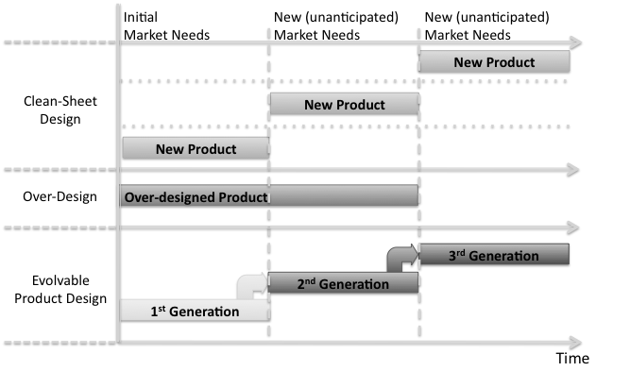
Evolvable
Notes:
You design for evolvability. There are different design approaches, each valid in their own right.
A clean sheet design might be very valid for a product that can be designed quickly. Each time an unanticipated change occurs, you redesign your product to meet the needs.
An over-designed product will short term cover many needs you foresaw. But over time it will run out of steam.
An evolvable product can be adapted to changes over time. An evolvable design is for example a great match for a product that is complex and requires a large investment (knowledge, time) to design.
We will argue that software falls in the last category of products: complex and time intensive to design.

Slide 10
Evolvable
an entity’s ability to “alter their structure or function so as to adapt to changing circumstances”
Robustness: Feature persistence under specified and unforeseen perturbations
Resilience: the ability to tolerate (or even profit from) the on-set of unanticipated changes and environmental conditions that might otherwise cause a loss of acceptable service
Notes:
Being evolvable is about the ability to acquire novel functions that help an organism survive in a changing environment. Software is in its nature static. But most enterprise software is required to adapt to a changing environment over time. Most of these changes are incremental and relatively small. Most of the time a business will evolve it’s systems rather than revolutionize it’s systems.
If the change is localized to a single system, life is usually not that complicated. However, we are talking about services here that are inherently open to a wide variety of consumers. What we want to avoid is having to:
Rewrite the service and all its consumers.
Pretend the change never happened and provide the new functionality through a new ‘splinter service’, ‘band-aid’ or ‘hack’.
The service has to be able to survive in a changing environment.

Slide 11
Evolvable
There is a strong connection between architecture and evolvability
Modular architecture increases ability to adapt:
Separate modules for functions not closely related
Confine each function to a single module and as few unique components as possible (change in a function is likely to impact all components providing that function)
Reduce nesting of modules
Collect functionality which is not anticipated to change into separate modules: decompose based upon volatility
Standardize and reduce number of interactions between modules
Support multiple representations (flexible shapes)
Notes:
There is a strong connection between a product’s architecture and the ease with which it can be evolved into future generations of products. Modular design is used in many industries, including electronics and car manufacturing. Utilizing a modular design to software increases evolvability.

Slide 12
Platforms: a moving target
Vehicle platform-sharing [….] enables automakers to sharply reduce product development and changeover times, while modular design and assembly allow building a greater variety of vehicles from one basic set of engineered components. Many vendors refer to this as product or vehicle architecture […]: the scheme by which the function of a product is allocated to physical components.
Notes:
We are all familiar with the term ‘platform’ referring to a raised, horizontal surface. But what does it mean to us from an engineering perspective? It is something to build upon. We do not go below the platform, the platform is our base.
Now, I do not typically like comparing software development to mass production. Mass production is tuned toward making the same product over-and-over again with very little variation. That problem at it’s core does not exist in software development. But when it comes to building platforms, software developers actually face some of the same challenges as car manufactures:
Designing the base components is expensive. A significant cost reduction can be achieved through re-use of components.
Over time, the demand changes. People want a different product or new features. Those demands however impact components at a different rate. Many components are not impacted by a change.
Vehicle platform-sharing combined with advanced and flexible-manufacturing technology enables automakers to sharply reduce product development and changeover times, while modular design and assembly allow building a greater variety of vehicles from one basic set of engineered components. Mass manufacturing of cars started out with very static designs. For example the Ford T, with few variations and colors. When they had to switch over to a new model, it took many months to change the production line. In the 70’s many automakers switched to utilizing a shared platform across multiple models.
Many vendors refer to this as product or vehicle architecture. The concept of product architecture is the scheme by which the function of a product is allocated to physical components. Please note that architecture is here defined as the way in which you utilize components.
The use of a platform strategy provides several benefits:
Greater flexibility between plants (the possibility of transferring production from one plant to another due to standardization),
Cost reduction achieved through using resources on a global scale,
Increased use of plants (higher productivity due to the reduction in the number of differences), and
Reduction of the number of platforms as a result of their localization on a worldwide basis.
The automobile platform strategy has become important in new product development and in the innovation process. The finished products have to be responsive to market needs and to demonstrate distinctiveness while — at the same time — they must be developed and produced at low cost. Adopting such a strategy affects the development process and also has an important impact on an automaker's organizational structure. A platform strategy also offers advantages for the globalization process of automobile firms.

Slide 13
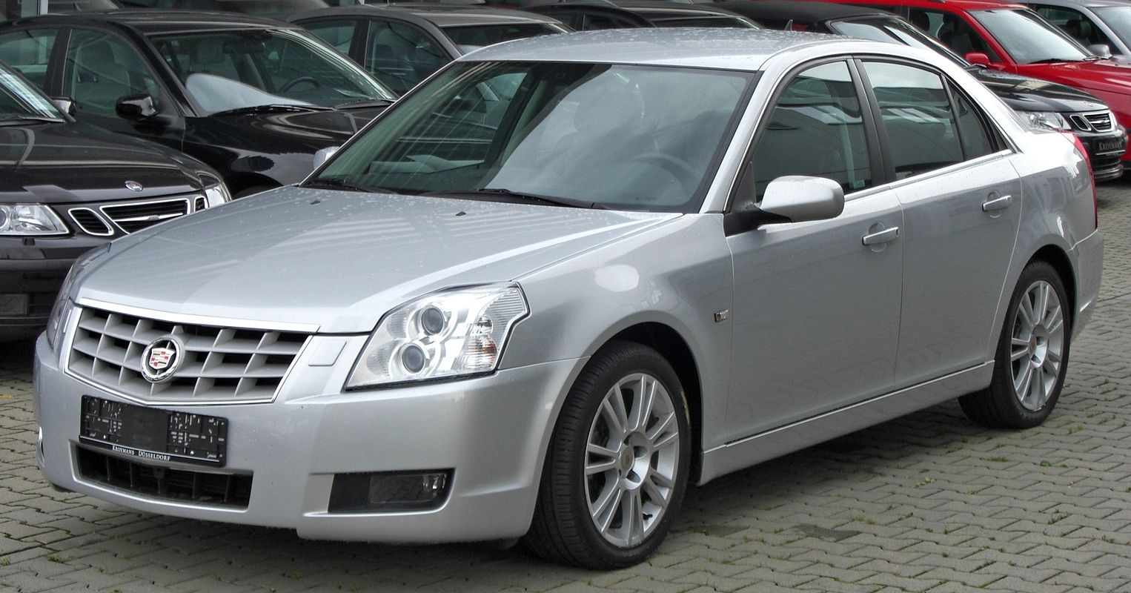
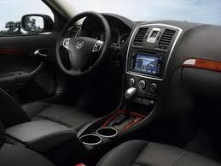
Cadillac BLS is …
Notes:
The result is that one …

Slide 14
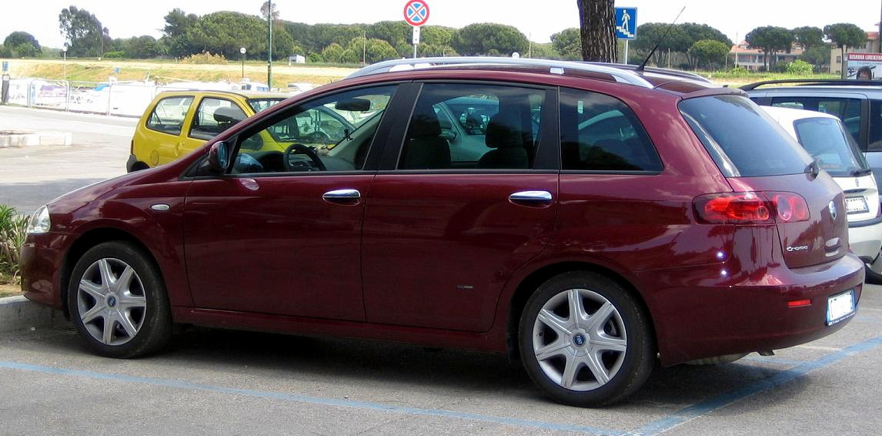

Fiat Croma
Notes:
Is just like the other.

Slide 15
Platforms: a moving target
Advantages:
Lower development costs
Increased quality and innovation
Greater product variety: platform sharing allows manufacturers to build and design differentiated products faster and cheaper.
Focus on consumer demand in different market segments (luxury versus mass-market) and in different global markets with the same platform.
Developing a new car from scratch is time, labor and knowledge intensive. Many cycles of design, prototyping and testing. Monetize that investment to the best of your ability.
Notes:
Advantages of platforms are;
Easier inventory management/smaller number of parts. Platform sharing allows for fewer parts for different models of vehicles and therefore the task of inventorying those parts is greatly reduced.
Lower development costs. Platform sharing allows manufacturers to cover many different market segments when a platform sharing strategy is implemented.
Increased quality and innovation: Platform sharing allows manufacturers to design parts with fewer variation. A byproduct of this is increased quality, which results in lower defect rates.
Global standardization. Platform sharing allows manufacturers to design flexible platforms that can be tailored to a country's specific needs without compromising quality. It also allows for manufacturing standardization and improved logistics.
Greater product variety. Platform sharing allows manufacturers to build/design differentiated products faster and cheaper. This is possible because the development and cost of the original platform have already been paid for.

Slide 16
Platforms
Disadvantages:
Incompatible changes to platforms
regression test!
Risk concentration
a defective component impacts multiple product

Slide 17
Platforms: driving success
Volkswagen:
245 models, 10 brands, 8.4 million vehicles sold in 2011
A refined modular strategy: standardizing parts across 40 small car models including engine mounts and ability to build on the same assembly lines.
Product development costs cut by 20%, parts cost cut by 20%, production time cut by 30%.
Notes:
A well executed platform strategy is one of the key drivers behind the success of one of the world’s largest car manufacterers: Volkswagen.
http://fortune.com/2012/07/10/volkswagen-das-auto-giant/
http://autoweek.com/article/car-news/vws-new-modular-platform-could-spark-revolution

Slide 18
Platform Architecture
Arrangement of functional elements
Decompose by volatility, not domain functionality
Mapping from functional elements to components
Component standardization
Specification of interfaces among interacting components
Interface standardization
Notes:
Architecture is the scheme by which the function is allocated to the components. Architecture is about the utilization of components to create functionality.
You should decompose your system based upon areas of potential change (volatility). Decomposition based upon domain functionality results in systems with low re-usability, usually decomposed in CRUD style.
Please note that an architecture with volatility based decomposition is also advocated by Juval Lowy ( for example http://www.oreilly.com/pub/e/3281 )

Slide 19
Platforms: software
Steve Yegge’s platform rant
All teams will expose their data and functionality through service interfaces
Teams must communicate with each other through these interfaces.
No other form of communication will be allowed.
All service interfaces must be externalizable. You must plan and design to be able to expose the interface to the outside world.
Notes:
Anyone here familiar with Steve Yegge’s Platform Rant ? https://plus.google.com/+RipRowan/posts/eVeouesvaVX
In short Steve Yegge is a software engineer who worked for about six and a half years at Amazon before going to Google. Although Amazon seems to do everything wrong, where Google does everything right, he notices Amazon has one big leg up: a mandate.
His Big Mandate went something along these lines:
1) All teams will henceforth expose their data and functionality through service interfaces.
2) Teams must communicate with each other through these interfaces.
3) There will be no other form of interprocess communication allowed: no direct linking, no direct reads of another team's data store, no shared-memory model, no back-doors whatsoever. The only communication allowed is via service interface calls over the network.
4) It doesn't matter what technology they use. HTTP, Corba, Pubsub, custom protocols -- doesn't matter. Bezos doesn't care.
5) All service interfaces, without exception, must be designed from the ground up to be externalizable. That is to say, the team must plan and design to be able to expose the interface to developers in the outside world. No exceptions.
6) Anyone who doesn't do this will be fired.
He goes on to note that Google does not understand platforms, they think in products. It's a big stretch even to get most teams to offer a stubby service to get programmatic access to their data and computations. Most of them think they're building products. And a stubby service is a pretty pathetic service. Stubby's great, but it's like parts when you need a car.
A product is useless without a platform, or more precisely and accurately, a platform-less product will always be replaced by an equivalent platform-ized product.
When developing a platform, you have to build on that platform yourself. Eat your own dog food. Platforms are all about long-term thinking.
Amazon was a product company too, so it took an out-of-band force to make Bezos understand the need for a platform. That force was their evaporating margins; he was cornered and had to think of a way out. But all he had was a bunch of engineers and all these computers... if only they could be monetized somehow... you can see how he arrived at AWS, in hindsight.
The Golden Rule of Platforms, "Eat Your Own Dogfood", can be rephrased as "Start with a Platform, and Then Use it for Everything." You can't just bolt it on later. Certainly not easily at any rate -- ask anyone who worked on platformizing MS Office. Or anyone who worked on platformizing Amazon. If you delay it, it'll be ten times as much work as just doing it correctly up front. You can't cheat. You can't have secret back doors for internal apps to get special priority access, not for ANY reason. You need to solve the hard problems up front.

Slide 20

Anyone who doesn’t do this will be fired

Slide 21
Platforms: software
A product is useless without a platform
a platform-less product will always be replaced by an equivalent platform-ized product
Eat Your Own Dog Food
Start with a Platform, and then Use it for Everything
No bolting on later
No secret backdoors for your internal applications
Notes:
What happens when you allow back doors? An example from our environment: we have a system write to a table in a database. The system sends out a message. The system that receives the message then also writes to the same table, assuming that the previous write has taken place. This turned out to be rather disastrous design once change came along. Although the systems appear to be loosely coupled through a message, they are actually very tightly coupled at database level.
Another example from our environment: a message is received and data is stored in the database. Later on, a stored procedure is used to copy data from this table to another system.
If you are building a service oriented platform, do NOT cause tight coupling beneath the platform.

Slide 22
An Evolvable Service Oriented Platform …
Is reusable
Is evolvable
Can be adapted to changes
Allows new variations
long-term thinking, monetize your current investment in the future
Can drive innovation and change
Is the world your products, and thus your consumers, live in
Notes:
A quick recap of what an evolvable service oriented platform is. Not only will a service oriented platform adapt to change, it will drive change.
If your reaction to a request for change is “ how can we accomplish this change without actually changing anything? “, your systems are probably not allowing for growth and innovation.

Slide 23
Implementing a Service Oriented Platform
Technology stack:
RESTful web service (on top of Web API)
Messaging (nServiceBus, SignalR)
Notes:
How are we implementing our service oriented platform? We have chosen RESTful web services (based upon Web API) combined with messaging (utilizing nServiceBus and SignalR). We will now dive deeper into why we use these technologies and what our guidelines are.

Slide 24
RESTful web services
Are evolvable:
They are resource oriented, not operation oriented
They are discoverable
self describing services: client application makes minimal assumptions about the resources available.
Client performs feature detection at run-time based upon a single entry point URL
Discoverability is necessary, HATEOAS (HyperMedia As The Engine of Application State) is not very practical in its extreme form
Notes:
RESTful web services are evolvable since they are:
not operation, but resource oriented. Operation oriented interfaces will be more highly impacted by changes than resources.
-self describing (links HATEOAS Hypermedia As The Engine of Application State). Resources describe their own interactions and capabilities.
In order to achieve evolvability, the REST constraints prevent our client applications from making certain assumptions. We cannot allow the client to know in advance about the resources that are available on the server. They must be discovered at runtime based on a single entry point URL.
Once the client has discovered the URL for a resource, it cannot make any assumptions about what types of representations might be returned. The client must use metadata returned in the response to identify the type of information that is being returned.
These limitations require building clients that are far more dynamic than a traditional client/server client. Clients must do a form of "feature detection" to determine what is possible, and they must be reactive to the responses that are returned.
Do NOT violate this principal, if you want to ensure evolvability.
High interoperability: built on core HTTP concepts. Can be accessed from a large variety of consumers.

Slide 25
RESTful web services (cont’d)
They are highly Interoperable
Built upon core HTTP concepts, supported by a wide range of infrastructure components and consumers
They are stateless, client has state
They have standardized support for:
caching
Key for performance
Key for managing the expiration of local copies of data
conditional requests
Optimistic concurrency control through Etags
Ranges (Paging)
Notes:
Stateless is a core architectural constraint of RESTful services. The client–server communication is constrained by no client context being stored on the server between requests. Each request from any client contains all the information necessary to service the request, and session state is held in the client. The session state can be transferred by the server to another service such as a database to maintain a persistent state for a period and allow authentication. The client begins sending requests when it is ready to make the transition to a new state. While one or more requests are outstanding, the client is considered to be in transition. The representation of each application state contains links that may be used the next time the client chooses to initiate a new state-transition.
Caching is also a key architectural component of RESTful services. Not only does it improve performance, it also allows us to manage the expiration of local copies of the data. Currently we already have many systems receiving local copies of data from other systems. But we have no way of managing the expiration. Once the consumer receives the local copy, the consumer has full control and the originating system looses all control. Caching allows us to specify that the consumer SHOULD check back with the originating system to check on the expiration, thus giving the origin server some control over expiration of the local copy. This is a key issue we hit in many systems.
Support for conditional requests allows us to use optimistic concurrency control and helps us prevent simultaneous updates of a resource overwriting each other.
Ranges allow us to implement paging in a universal standardized pattern understood by intermediate caching solutions.
The really neat thing: all these features exist out of the box in RESTful services an are highly interoperable. You don’t need to define your approach to paging or optimistic concurrency.

Slide 26
Web service design guidelines
Define the minimal set of information required
Do not include information just because it is in the database
Define a core set of information that is commonly used
Identify relationships between the information
Relationships become discoverable links
Classify the types of aggregations, filtering, and statistics needed
Avoid consumer having to aggregate or filter large amounts of data
Notes:
Forget your specific application or database. Think about the service as a stand alone entity.

Slide 27
Web service pitfalls
Logical coupling
Performance
Binary protocols, caching, horizontal scalability
Database as a service
Thinking in operations, CRUD, tables
No discoverability
Over constrained
Requiring optional elements, limit operations
Notes:
Logical coupling: creating strong coupling between concepts that are not strongly coupled to start with. For example: the relationship between an order and its shipping address is much looser than the relationship between an order and the order details. If you include the order and shipping address in a single resource, you created a coupling that will limit the changes you can make to the system over time.
Every time I mention performance, people seem to get highly defensive: performance is not a problem, we don’t have a high volume like that, you should not optimize for performance when you don’t have to.
Yes, you shouldn’t optimize for performance when you do not have to, but not designing for performance is just plain silly. Remember: the service oriented platform is our world. Services are the platform, the one and only thing that we are building upon. Not ever will you be able to bypass the services to get to a resource. You will want performance and you will truly want to consider:
Fast binary protocols for internal service calls (for example protobuf)
Caching support (RESTful API’s have very rich caching semantics, use them). Do not pre-exclude caching support from your stack. Although caching is difficult, it is a key part of RESTful API’s.
Horizontal scalability. Do not ever break the paradigm that services are stateless.
Database as a service: your service is a simple CRUD representation of the database. This severely decreases your ability to evolve the service over time. It is basically the lowest level of an operations based API.
No discoverability included: the client can’t detect features based upon metadata.
Over constrained means you put limitations on data or operations when not needed, requiring optional elements, …

Slide 28
Messaging
Push (events, commands)
a paradigm of breaking business processes to an "evolvable web of events" in which any "significant" business step generates a durable event that can be further processed independently.
Notes:
Messaging allows us to push events or commands. Messaging provides us the duality of web services. At the Bank messaging was a very common pattern, but there were very few web service built. This caused a rather unbalanced architecture where senders controlled everything and consumers were more or less ‘mindless drones’. For example: the sender creates a request to perform an action and sends along exactly the data needed for that operation. This creates a rather inflexible design where a change in a one single consumer (for example requiring an additional piece of data) potentially causes a change in the sender (and maybe even all other consumers).
Web services return the control to the consumer.
We support two scenario’s: enterprise level messaging (transactional, fault tolerant) MSMQ and client facing messaging (SignalR, less fault tolerant).
Although messaging might sound like an IBM mainframe concept, messaging it is a hot topic in cloud computing right now for reactive actor based architectures. http://www.infoq.com/articles/reactive-cloud-actors
By reducing dependency, coupling of the elements of the system diminishes allowing for evolvability of the system. Behaviour of each actor can be independently modified and in fact, each actor can be deployed independently of others. Reduced dependency is one of the most important virtues of an actor-based system. It leads to the simplification of design, reducing dependency and decoupling elements comprising an application.

Slide 29
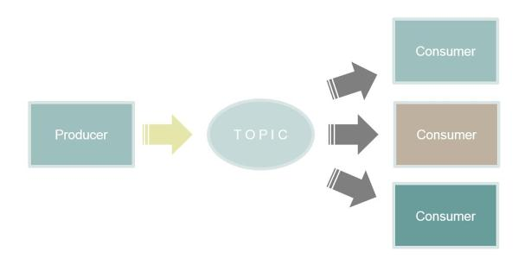
Messaging: events
Notes:
Dependency Injection (DI) is a mainstay of conventional software development and is a pattern of achieving the Inversion of Control principle. Events in a loosely-coupled architecture achieve the same goal that DI achieves in a piece of software. By removing the knowledge of the consumers from the producer of an event, we achieve the same degree of decoupling.
This is basically the same Hollywood Principle "Don't call us, we'll call you" that is used in dependency injection. Using events lead to reactive programming that has been gaining popularity over the last few years. Using Reactive Programming (such as Reactive Extensions - Rx) simplifies dependency networks in a complex software, while using Reactive and event-driven architecture (as described in the Reactive Manifesto) can lead to a highly decoupled and evolvable architecture.

Slide 30
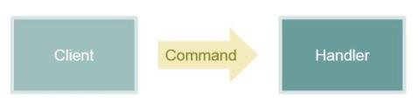
Messaging: commands

Slide 31
Messaging pitfalls
Message for transporting data
Message is not a web service
No caching
No expiration
No ability to retrieve data when the CONSUMER needs it
No flexibility for the consumer to change the content or format of the data received.
Web services are consumer driven, messages are publisher driven.
Logical coupling
Notes:
Transporting large amounts of data through messages: although it seems like a great way of guaranteed delivery of your data, messaging system have not been built to handle a large number of messages that each have a large data content. An example from our environment: sending 12000 messages each night to copy 12000 rows of data between two databases.
It is an easy trap to think about a message as a transactional mechanism for copying data between two databases. It is however more appropriate to think of messaging as an asynchronous event system, although that does come with some complications around timing: you have to ensure that the data retrieved by the consumer of the message is consistent with the state of the data when the message was sent. For example: if the data was changed while the message was in transit, you might have to ensure that you can identify the original data (for example through version stamp). This will differ by scenario, but it is obviously easier when the message contains a snapshot of all relevant data at the point in time that the message was created. That approach is just not very practical.
Logical coupling: do not include details of a the order and the shipping address in the same message. A message should only contain the minimum identifying information needed. For example: an order id, a timestamp and URI’s for accessing the data. See Andreas Ohlund, chief engineer at nServiceBus,talk about this: https://skillsmatter.com/skillscasts/2990-events-diet

Slide 32
An example: Retrieving data through FTP
On demand, get data from an outside entity (through FTP in this particular case)
A consumer requests new data. This data has to be retrieved from an external party through FTP.
Architecture components
A web service that the consumer can send the request to and retrieve the data from
Accessible for a wide range of consumers
An actor for retrieving the FTP file (Windows Service)
Long running process, encapsulate actual communication protocol used (FTP)
Notes:
Advantages: any client can start this process (from a browser, phone, …) and the service knows a request is outstanding (can for example change state to reflect the data is in the process of being updated, change cache, …)
A POST is not safe and not idempotent. The service can however choose to track for example the number of outstanding requests per user or system requesting the data or throttle the number of requests.
Based upon metadata from the web service, the requestor finds out the URI for the resource to request processing.
Web service sends a message to start the processing by the actor. The message includes an ID for the initial request and a URI to post the result to.
Web API updates internal state to reflect the request was queued.
Web API returns 202 (Accepted) status and a URL for monitoring the current status (and any additional info like an identifier if needed)

Slide 33
An example: Consumer request
Consumer/client calls Web API for discovery of available functionality
Retrieve profile with links from Web API
Consumer finds the URL for requesting the new data
Consumer/client POST’s a request for pulling new data to a Web API. Consumer receives as a reply:
A 202 (Accepted) status code indicating the request was received and processing started
A URL to poll for the status (optional, client can poll, fire-and-forget or, if supported, wait for a message to notify that request was completed)
Notes:
The polling is completely optional. If you have a very simple consumer, polling might be the only option. If you have a client that can receive messages, you can also not poll and simply handle the message stating the data has been loaded.
A note on profiles: there is no widely accepted standard around web service profiles for Web API. You can look at Google’s discovery service https://developers.google.com/discovery/v1/using or for example the HAL browser http://haltalk.herokuapp.com/explorer/browser.html#/
The core concept is named links: links with an associated name. You look for a link with the given name. Yes, we are now hard coding dependencies upon the name of a link. But a completely flexible discovery is complicated, because it includes semantics that are difficult to infer. You are however still achieving decoupling from physical URL’s.
You will also need to be able to handle templated URL’s: there are some open source implementations of RFC6570 (for example https://www.nuget.org/packages/Resta.UriTemplates/ )
Lastly you will want to hook in to Web API’s routing and be able to generate these links based upon either named routes or lambda’s over action methods inside your Web API controllers. We have implemented this, please ask for details if you are interested.
Finally: how do you send links? Again, there is no single standard, but we allow a LINK header and also handle a _links collections in the JSON document (supported through a single ‘IHaveLinks’ interface for objects in .NET).

Slide 34
An example: Consumer request
POST is not idempotent: if the service fails, consumer will have to retry by creating a new request
There is a potential that the request was created but the service failed before sending a reply.
Either accept in this scenario the potential for multiple requests
or
The web services tracks outstanding requests per consumer (for example user identifier, consumer license key, …) and re-uses those when needed

Slide 35
An example: discovery
Consumer
Create Request for profile
Service
Send profile
Consumer
Find URL for creating FTP request

Slide 36
An example: Web API request handling
Web API receives a request for new data
Creates a unique id for the request
Sends a message to the actor, requesting retrieval of the FTP file. The request contains a URL to post the result to. The URL includes the unique ID.
Sends a 202 (Accepted) status back to the consumer/client, which includes a URL for polling the status of the request. The URL includes the unique ID
Polling requests are answered based upon whether a resource exists for the unique ID.
If exists, reply 303 (See Other) with a URL for the created resource
Else reply 200 (OK) to indicate still waiting
Notes:
Note that we create a recoverable message, so we can guarantee the request is completed eventually, even when servers go down.

Slide 37
An example: send request
Consumer
Create Request
Service
Create Unique ID
Send command message to actor
Consumer
Poll for status
Send reply with Polling URL

Slide 38
An example: Actor
Receives message.
Gets the data across FTP.
The actor sends the data to the URL given in the message (PUT)
Receives from the web service a status code 201 (Created) and the URL for the created resource
When operation fails, the actor needs retry logic.
PUT is idempotent (using a unique ID, multiple calls have same result), so even if web service failed after creating resource, but before sending response, there is no problem
Actor is transactional: if the FTP retrieval fails, the command message remains in the queue

Slide 39
An example: Web API result handling
The Web API then
Exposes the updated resource.
Publishes an event message to notify actors that the resource was updated, including the URL for the resource.
nServiceBus and/or SignalR
replies to any polling requests on the state of the particular load that the data has been loaded with a link to the created resource.
Notes:
Please note that the windows service and the Web API function independently.
You can send a request to the Windows Service to get the FTP file outside of the Web API.
You can update the resource on the Web API without utilizing the Windows Service.
But you can also dedicate the windows service completely to the Web API (for example through security settings).

Slide 40
An example: retrieve file
Service
Create message with response URL
Actor
Retrieve file through FTP
Service
Update resource
Send data to URL
Send event message
Reply with URL for new resource

Slide 41
An example: recap
Use of components
FTP access separated from web service
Actor sends FTP data to the web service, not a database
Discoverability
Location of the service profile was the only assumption made about a resource location
Evolvable
Combination of web service and messaging provides extensibility (resilient to change) and robustness (functionality of public interface can be provided unchanged by many different implementations)
Notes:
So what did we accomplish in this example?
We utilized clearly defined components, decomposed based upon volatility (changes in the retrieved file from the 3rd party impact only the actor and not the web service).
A discoverable service. The Web API service sends the actor and consumer in each step the URL of the resources involved. The location of the service profile was the only assumption made.

Slide 42
Stuff we needed …
Framework we have implemented:
Highly scalable WEB API Cache and 2nd level ORM cache using Couchbase
Discoverability (service profile, link sharing, link templating)
Validation (validation results accessible for client)
Extensions for status codes, ranges, conditional requests, strategy for generating ETags
Notes:
There were a couple of things we needed to implement this architecture. We would love to walk through each of these items with you and talk code, but that would probably take a whole day ☺.
We hope that the design philosophy and architecture we shared today will inspire and help you.
Please feel free to contact me, marco.rentier@fhlbtopeka.com
Keep coding ☺.

